Slide 1
ABSTRACT
Digit recognition is one of the active research topics in digital image processing. It is a classic machine learning problem. The goal of this project is to take an image of handwritten digits and determine what those digits are. The principal task in digit recognition is to extract HOG features from the database of handwritten digits and to build a classifier on it. Then we predict the digits of the database using this classifier. To build the classifier we write python scripts.

Slide 2
PROBLEM STATEMENT
The goal of this project is to create a model that will be able to recognize and determine the handwritten digits from its image by using the concepts of Convolution Neural Network. Though the goal is to create a model which can recognize the digits, it can be extended to letters and an individual’s handwriting. The major goal of the proposed system is understanding Convolutional Neural Network, and applying it to the handwritten recognition system.

Slide 3
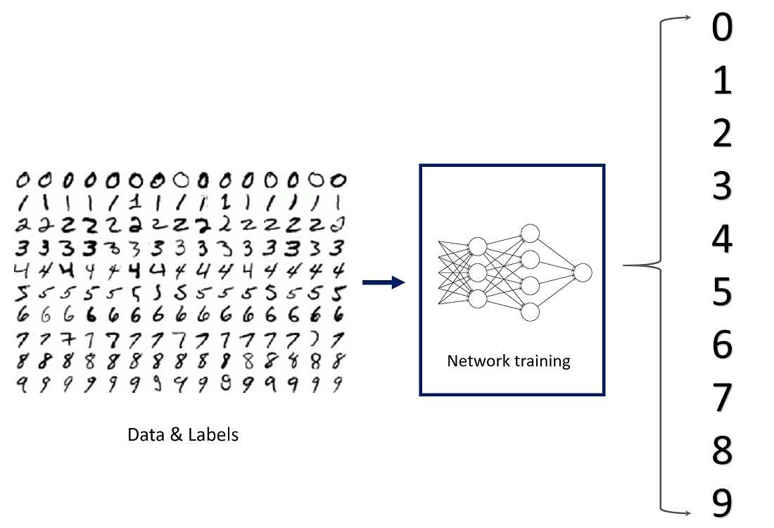
The basic principle of the project

Slide 4
why conventional neural network
It is the one of the most powerful supervised deep learning techniques.
In addition to the regular NN ,here we use an loss function and an optimizer.
By using CNN the image size can be reduced significantly.Therefore huge amount of data can be processed easily.

Slide 5
A Quick glimpse of Layers in Conventional Neural Network
There are many layers in CNN,but we mainly focus on 3 layers.They are
Conventional layers
Polling Layers
Fully Connected Layers

Slide 6
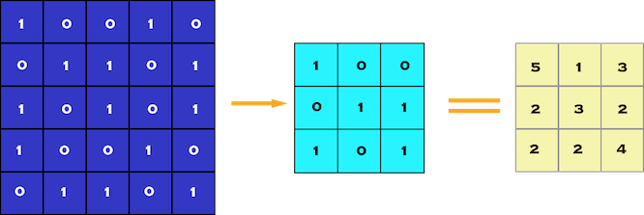
CONVOLUTIONAL LAYER
Convolutional layer is the very first layer where we extract features from the images in our datasets. Due to the fact that pixels are only related with the adjacent and close pixels, convolution allows us to preserve the relationship between different parts of an image. Convolution is basically filtering the image with a smaller pixel filter to decrease the size of the image without loosing the relationship between pixels. When we apply convolution to 5x5 image by using a 3x3 filter with 1x1 stride (1 pixel shift at each step). We will end up having a 3x3 output (64% decrease in complexity).

Slide 7
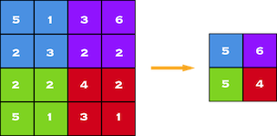
POOLING LAYER
When constructing CNNs, it is common to insert pooling layers after each convolution layer to reduce the spatial size of the representation to reduce the parameter counts which reduces the computational complexity. In addition, pooling layers also helps with the overfitting problem. Basically we select a pooling size to reduce the amount of the parameters by selecting the maximum, average, or sum values inside these pixels. Max Pooling, one of the most common pooling techniques, may be demonstrated as follows:

Slide 8
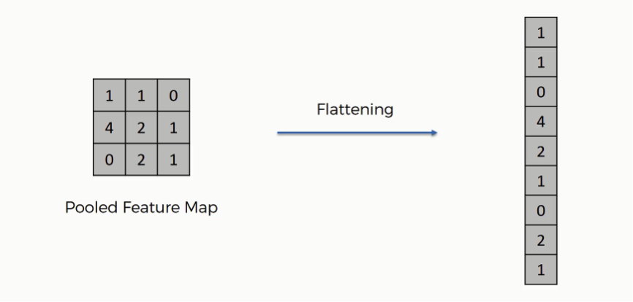
FLATTEN LAYER
A flatten layer collapses the spatial dimensions of the input into the channel dimension

Slide 9
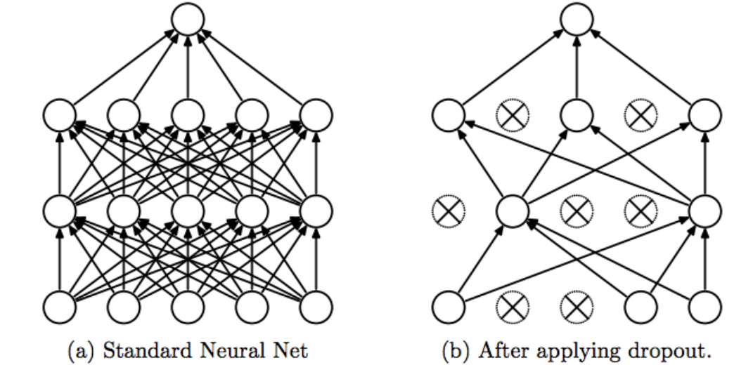
DENSE LAYER AND DROPOUT LAYER
Dense layer
Dense Layer is regular layer of neurons in Neural Network. Each neuron receives input from all previous neurons. Hence it forms Dense Layer. This layer represents matrix vector multiplication. The values in this matrix are trainable parameters which gets updated during Back Propagation. Dense layer is also used to change the values of matrix.
Drop out layer
A dropout layer is used for regularization where you can randomly set some of the dimensions of your input vector to be zero. A dropout layer does not have any trainable parameters, they can be updated during training.
Dropout is a technique which is used to get hold of Overfitting. This method takes input between 0 and 1. Dropout consists of randomly setting fraction rate of inputs to 0 at each update during training, which can help in preventing overfitting.

Slide 10
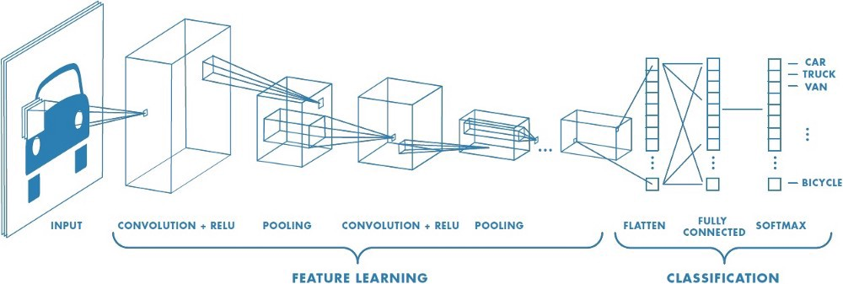
Overview of complete convolution neural network

Slide 11
Steps to build the Model
Import the data (training+testing)
Reshaping and Normalising the data
Building the CNN
Optimizing the Model
Evaluating the Model

Slide 12
MNIST DATASET
Samples provided from MNIST (Modified National Institute of Standards and Technology) dataset includes handwritten digits total of 70,000 images consisting of 60,000 examples in training set and 10,000 examples in testing set, both with labeled images from 10 digits (0 to 9). This is a small segment form the wide set from NIST where size was normalized to fit a 20*20 pixel box and not altering the aspect ratio. Handwritten digits are images in the form of 28*28 gray scale intensities of images representing an image along with the first column to be a label (0 to 9) for every image. The same has opted for the case of the testing set as 10,000 images with a label of 0 to 9.

Slide 13
Downloading the Mnist Data
API’s Used
TensarFlow
Keras
The code to import Dataset is given below.

Slide 14
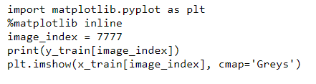
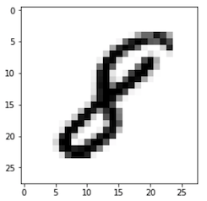
The visual representation of the number at any index can be get by using the following code

Slide 15
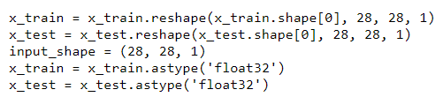
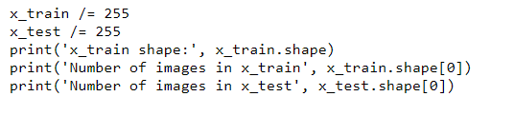
Reshaping and Normalizing the Model
The following code will do the Reshaping
The following code will do the Normalizing

Slide 16
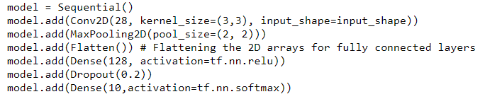
Building the Conventional Neural Network
Here we use need to use several keras modules,so we need to import them first.
Now we need to create the model and add the supporting layers.

Slide 17
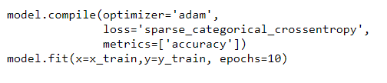
Optimizing the Model
Here by using the loss function,optimizer function and metrics we can optimize the model.

Slide 18

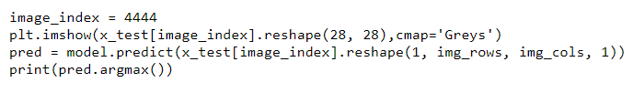
Evaluating the Model
The final step now arises,after building the model we need to test it.
The evaluation is done to overall epochs .
Code for Evaluating Manually
The above will give the exact prediction of a single image

Slide 19
REFERENCES
https://www.youtube.com/watch?v=3LowbgZsB8Y&feature=youtu.be
https://medium.com/@himanshubeniwal/handwritten-digit-recognition-using-machine-learning-ad30562a9b64
https://www.pantechsolutions.net/handwriting-recognition-using-opencv-python
https://machinelearningmastery.com/handwritten-digit-recognition-using-convolutional-neural-networks-python-keras/

Slide 20
THE END

